Slide 1
Agile Metodology & Scrum Framework
</ M Beny Pangestu >

Slide 2
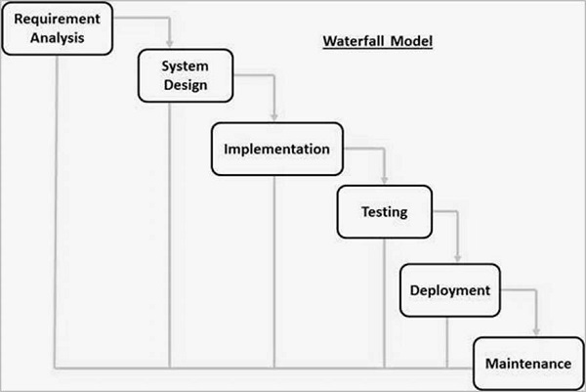
Waterfall Model

Slide 3
Waterfall Model
Changes
REQUIREMENTS
DESIGN
DEVELOPMENT
Skipped
Takes too long
TESTING
MAINTENANCE

Slide 4
Waterfall Model
This approach is highly risky,
often more costly and generally
less efficient than Agile approaches

Slide 5
Why we have to MoveOn from Waterfall
Using sequential approach. So when one step getting problem, the next step will delayed.
Waiting step by step, to go to next step.
If the previous step is stopped, can't continue to next level.
One process did by specialist on their part. If the process is skipped/stopped, the specialist is not used again.

Slide 6
Problem in Sofware Development
Miss-Communication Requirement
Addition requirement in development process

Slide 7
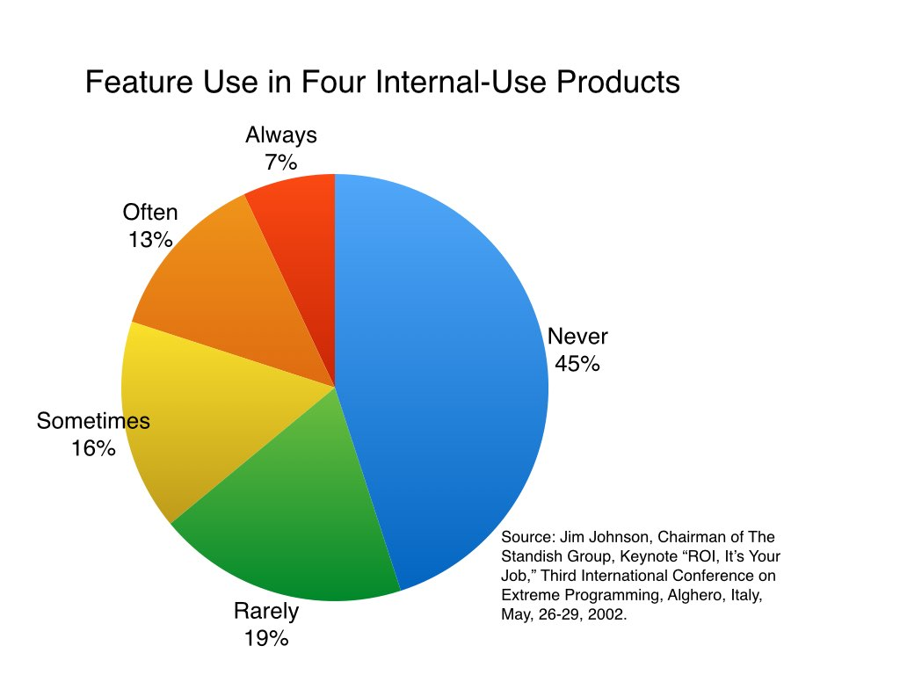
Feature Use Review in Internal Product

Slide 8
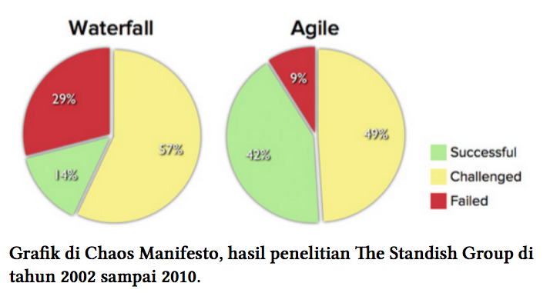
Why we have to MoveOn from Waterfall

Slide 9
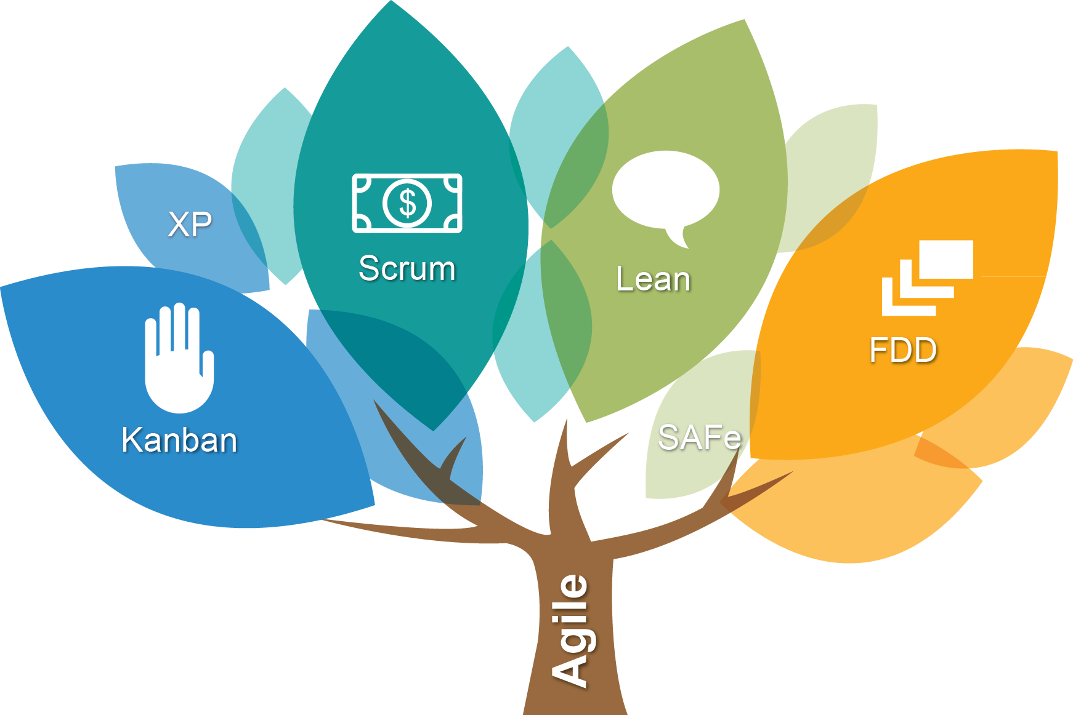
Agile Software Development

Slide 10
Agile Overview
“Agile projects succeed when the team gets the spirit of agility.”
– Ron Jeffries (APM Group)

Slide 11
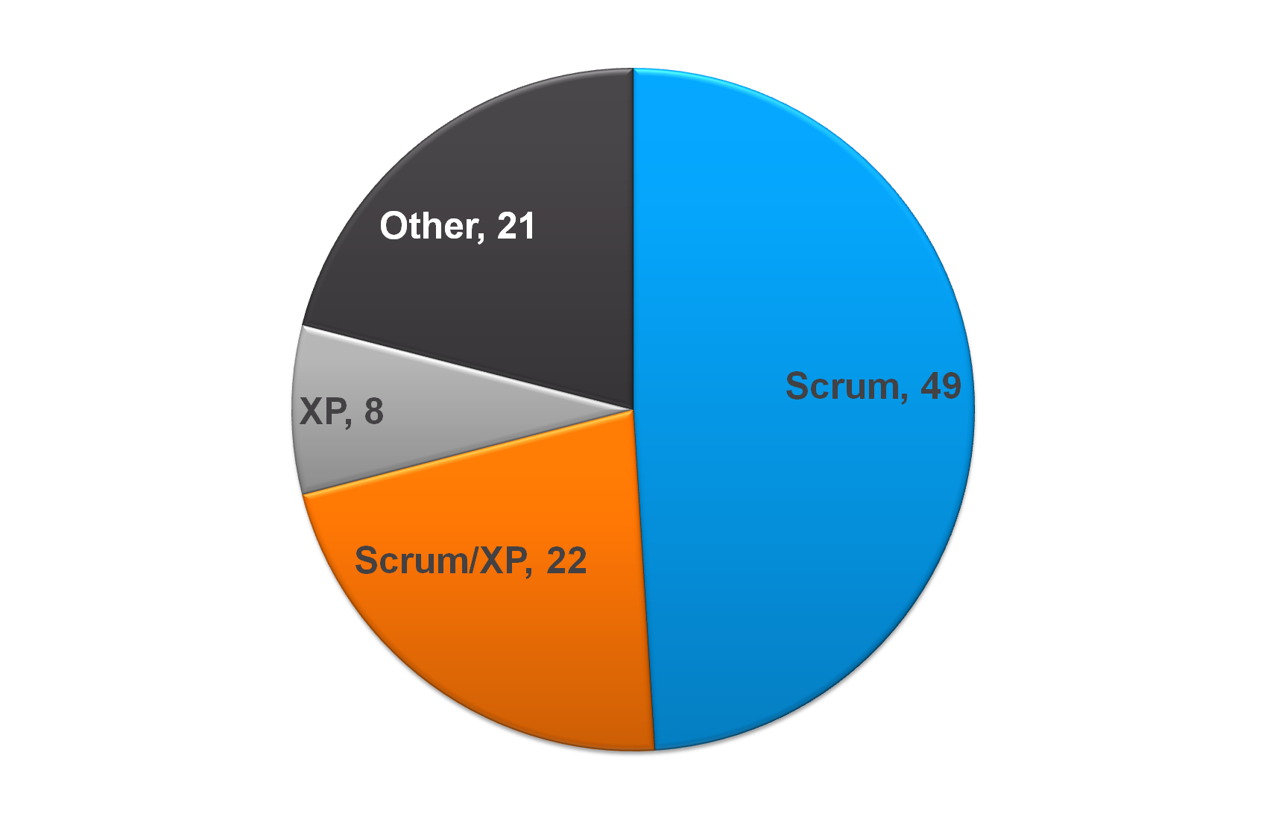

Slide 12
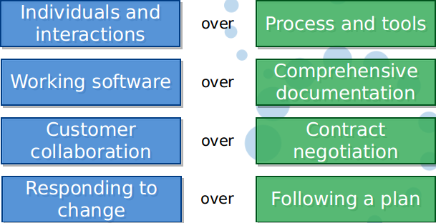
Agile Manifesto

Slide 13
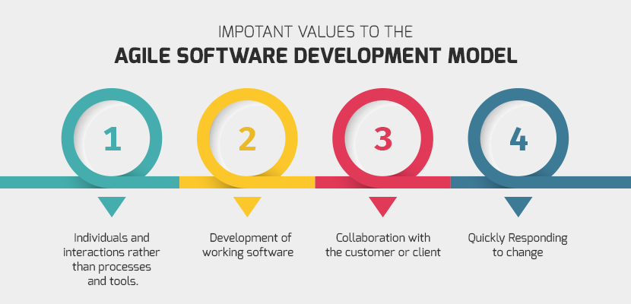
Important value in Agile

Slide 14
Most Agile methodologies have similar concepts.

Slide 15
Agile Concept
Iterative Development
Working from list
Develop one small feature at a time
Sustainable pace
Lean management hierarchy
Production ready deliverable
Continuos integration
Inspect and Adapt

Slide 16
Kanban
Delivers iterationless development
Kanban limits create a pull system
White board provides visualization of flow through to delivery

Slide 17
Kanban Foundational Principles
Start with what you do now
Agree to pursue incremental, evolutionary change
Respect the current process, roles, responsibilities & titles

Slide 18
Kanban Five Core:
Visualize the workflow
Limit W.I.P. (work in process)
Manage Flow
Make Process Policies Explicit
Improve Collaboratively (using models & the scientific method)

Slide 19
Why Must SCRUM ?

Slide 20
Scrum Introduction

Slide 21
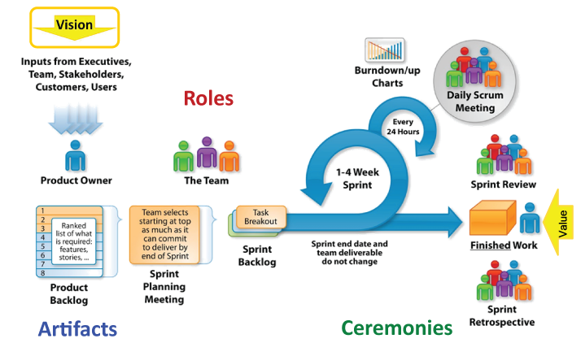

Slide 22
Who Used Scrum
Microsoft
Yahoo
Google
Electronic Arts
High Moon Studios
Lockheed Martin
Philips
Siemens
Nokia
Capital One
BBC
Intuit
Intuit
Nielsen Media
First American Real Estate
BMC Software
Ipswitch
John Deere
Lexis Nexis
Sabre
Salesforce.com
Time Warner
Turner Broadcasting
Oce

Slide 23
Scrum has been used for :
Commercial software
In-house development
Contract development
Fixed-price projects
Financial applications
ISO 9001-certified applications
Embedded systems
24x7 systems with 99.999% uptime requirements
the Joint Strike Fighter
Intuit
Nielsen Media
First American Real Estate
BMC Software
Ipswitch
John Deere
Lexis Nexis
Sabre
Salesforce.com
Time Warner
Turner Broadcasting
Oce

Slide 24
Scrum Characteristic
Self-organizing teams
Product progresses in a series of month-long “sprints”
Requirements are captured as items in a list of “product backlog”
No specific engineering practices prescribed
Uses generative rules to create an agile environment for delivering projects
One of the “agile processes”

Slide 25

Scrum Framework
Roles
Ceremonies
Product Owner
Scrum Master
Dev Team
Sprint planning
Sprint review
Sprint retrospective
Daily scrum meeting
Artifacts
Product backlog
Sprint backlog
Burndown charts
Shippable increment

Slide 26
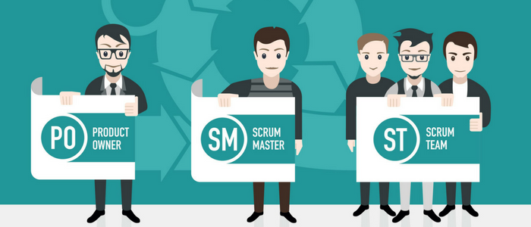
Scrum Roles

Slide 27
Product owner
Define the features of the product
Decide on release date and content
Be responsible for the profitability of the product (ROI)
Prioritize features according to market value
Adjust features and priority every iteration, as needed
Accept or reject work results

Slide 28
Scrum Master
Represents management to the project
Responsible for enacting Scrum values and practices
Removes impediments
Ensure that the team is fully functional and productive
Enable close cooperation across all roles and functions
Shield the team from external interferences

Slide 29
Scrum Team
Typically 5-9 people
Cross-functional:
Programmers, testers, user experience designers, etc.
Members should be full-time
exceptions (e.g., database administrator)

Slide 30
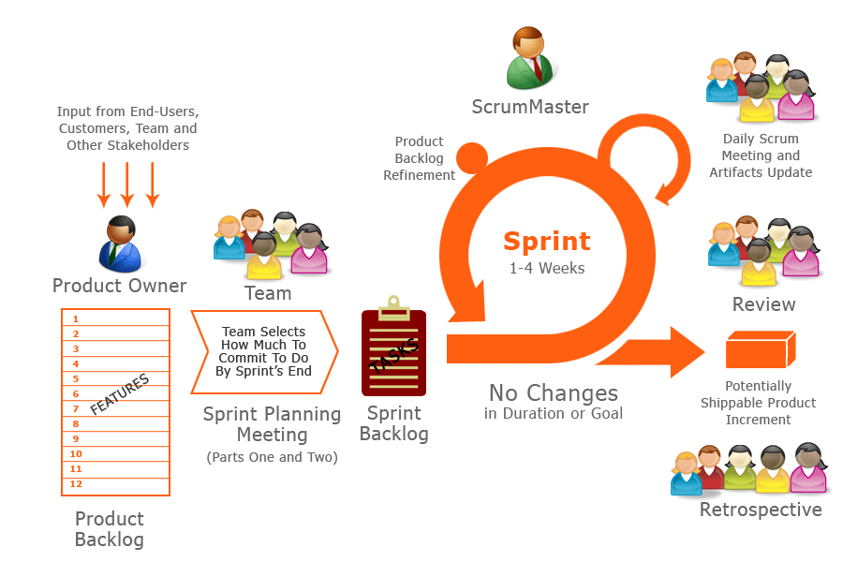
Ceremonies

Slide 31



Sprint planning
Team capacity
Sprint planning meeting
Sprint prioritization
Product backlog
Sprint
goal
Analyze and evaluate product backlog
Select sprint goal
Business conditions
Sprint planning
Decide how to achieve sprint goal (design)
Create sprint backlog (tasks) from product backlog items (user stories / features)
Estimate sprint backlog in hours
Current product
Sprint
backlog
Technology

Slide 32
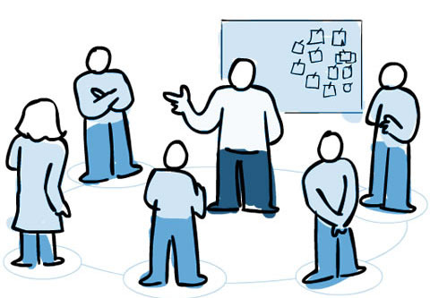
The daily scrum meeting
Parameters
Daily
15-minutes
Stand-up
Not for problem solving
Whole world is invited
Only team members, ScrumMaster, product owner, can talk
Avoid other unnecessary meetings

Slide 33

The daily scrum meeting
Everyone answers 3 questions
1
What did you do yesterday?
2
What will you do today?
3
Is any problem in your way?
These are not status for the ScrumMaster.
But, This is their commitments in front of peers

Slide 34
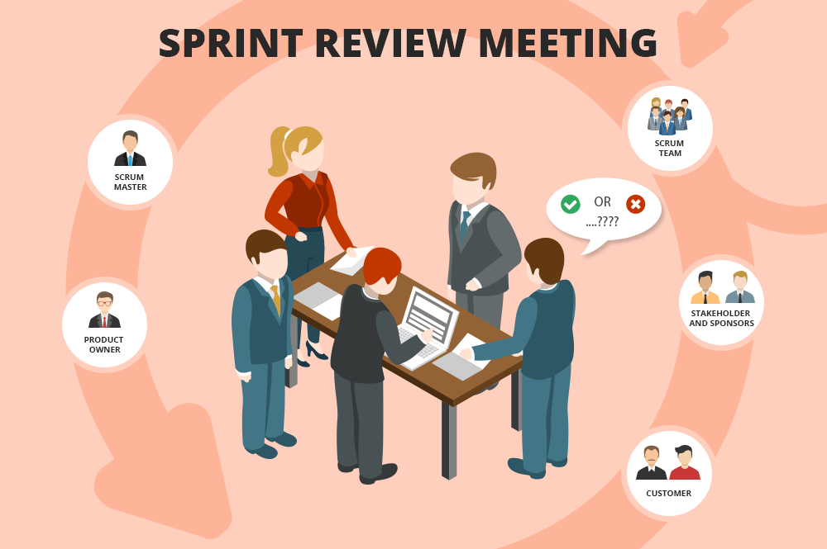
The sprint review

Slide 35
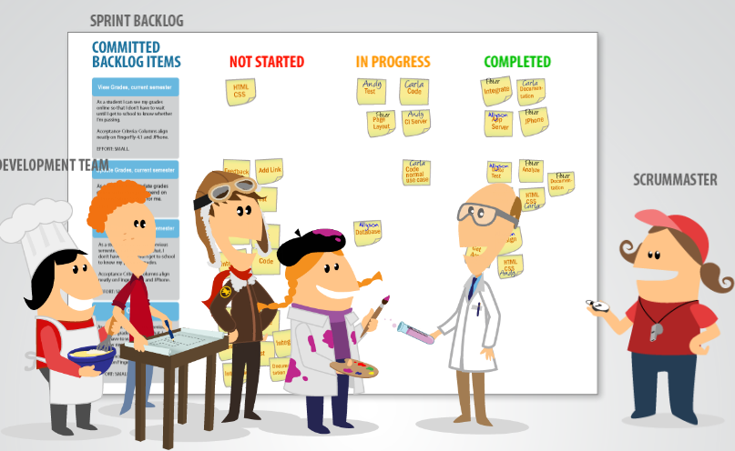
The sprint review
Team presents what it accomplished during the sprint
Typically takes the form of a demo of new features or underlying architecture
Informal
2-hour prep time rule
No slides
Whole team participates

Slide 36

Sprint retrospective

Slide 37
Sprint retrospective
Whole team gathers and discusses what they’d like to :
Start doing
Stop doing
Continue doing

Slide 38
Sprint retrospective
Periodically take a look at what is and is not working
Typically 15–30 minutes
Done after every sprint
Whole team participates
ScrumMaster
Product owner
Team
Possibly customers and others

Slide 39
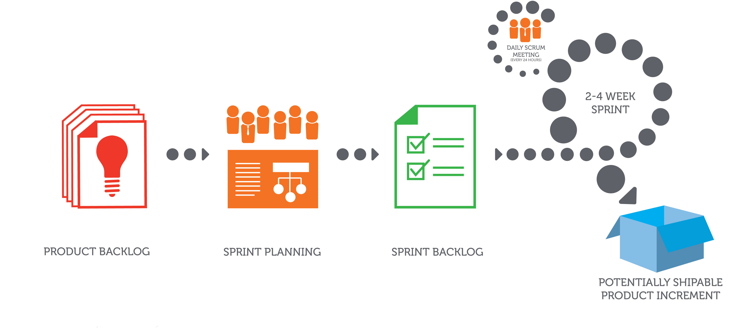
Scrum Artifacts

Slide 40

Product Backlog
The requirements
A list of all desired work on the project
Ideally expressed such that each item has value to the users or customers of the product
Prioritized by the product owner
Reprioritized at the start of each sprint
This is the product backlog

Slide 41
A sample product backlog
Backlog item | Estimate
Allow a guest to make a reservation | 3
As a guest, I want to cancel a reservation. | 5
As a guest, I want to change the dates of a reservation. | 3
As a hotel employee, I can run RevPAR reports (revenue-per-available-room) | 8
Improve exception handling | 8
... | 30
... | 50

Slide 42
The sprint goal
A short statement of what the work will be focused on during the sprint
Life Sciences
Support features necessary for population genetics studies.
Database Application
Make the application run on SQL Server in addition to Oracle.
Financial services
Support more technical indicators than company ABC with real-time, streaming data.

Slide 43
A sprint backlog
Tasks
Mon
Tues
Wed
Thur
Fri
Code the user interface
8
4
8
Code the middle tier
16
12
10
4
Test the middle tier
8
16
16
11
8
Write online help
12
Write the foo class
8
8
8
8
8
Add error logging
8
4

Slide 44
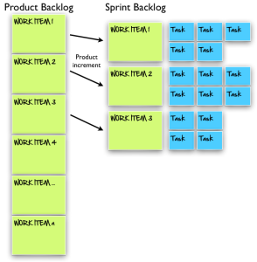
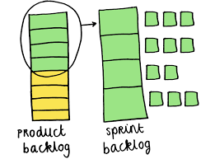
Managing the sprint backlog
Any team member can add, delete or change the sprint backlog
If work is unclear, define a sprint backlog item with a larger amount of time and break it down

Slide 45
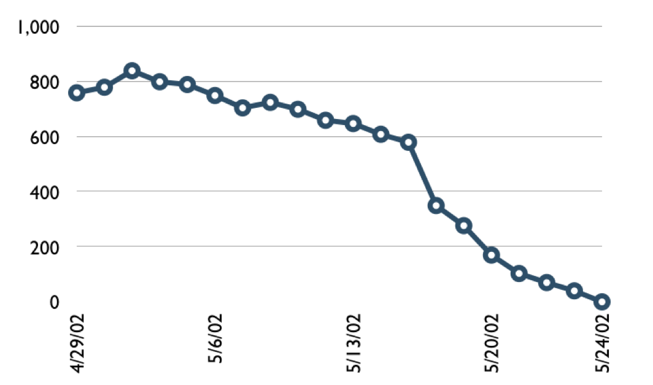
A sprint burndown chart

Slide 46
Scrum in 100 Word
Scrum is an agile process that allows us to focus on delivering the highest business value in the shortest time.
It allows us to rapidly and repeatedly inspect actual working software (every two weeks to one month).
The business sets the priorities. Teams self-organize to determine the best way to deliver the highest priority features.
Every two weeks to a month anyone can see real working software and decide to release it as is or continue to enhance it for another sprint.

Slide 47
"Scrum is not only about metodology and frameworks, Scrum is habit"
~ Ken Schwaber

Slide 48
Reference
https://www.scrumguides.org/docs/scrumguide/v2017/2017-Scrum-Guide-US.pdf
www.scrumalliance.org
Agile and Iterative Development: A Manager’s Guide by Craig Larman
Agile Estimating and Planning by Mike Cohn
Agile Project Management with Scrum by Ken Schwaber
Agile Retrospectives by Esther Derby and Diana Larsen

Slide 49
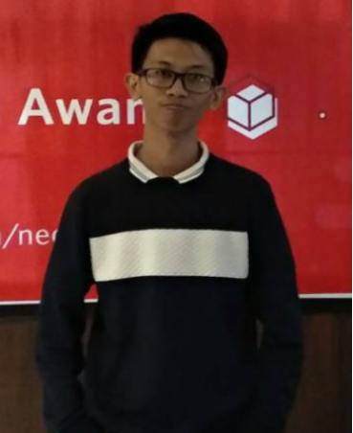
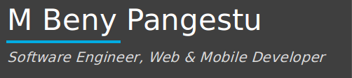
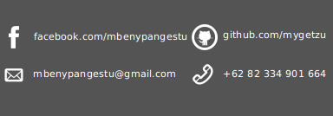
Contact Information

